Slide 1

Capstone Project - 2
Team 5 :
Cars24 revenue prediction
Team Members
RATAN YADAV
RITESH KHATUA
AKSHAY VITHAL YADAV
RAMADEVI BELLAMKONDA
MANISH SUNIL DANGE
RASHMI R B
MENTORS
MR. RAJASHEKAR SIR
MISS PALLAVI MA’AM

Slide 2
Content
Problem statement
Web Scraping and Create a Data frame
Data Summary
Analysis of different datasets
Data Pre-processing
Imputing missing values
Outlier treatment
Different Model Performance
Deployment
Challenges
Conclusion
Future Scope

Slide 3

Problem Statement
As we know the concept of Data science and ML is useful in many of the domains, in which one of the emerging domains is Automobile. As we can upfront build predictive models to forecast the revenue of the company, loyal customers analysis. Survival period of the machines etc. and a lot of analysis we can perform and prescribe too.
The main objective is that if a client establishes the business whether they can survive in the present market, and at what % of market share will be hold by the different companies.

Slide 4
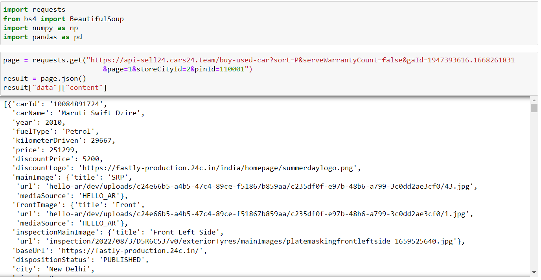
WEB SCRAPING AND CREATE A DATA FRAME

Slide 5
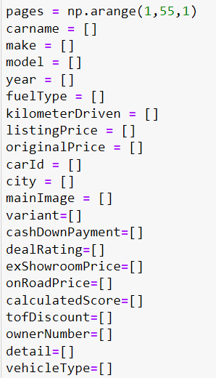
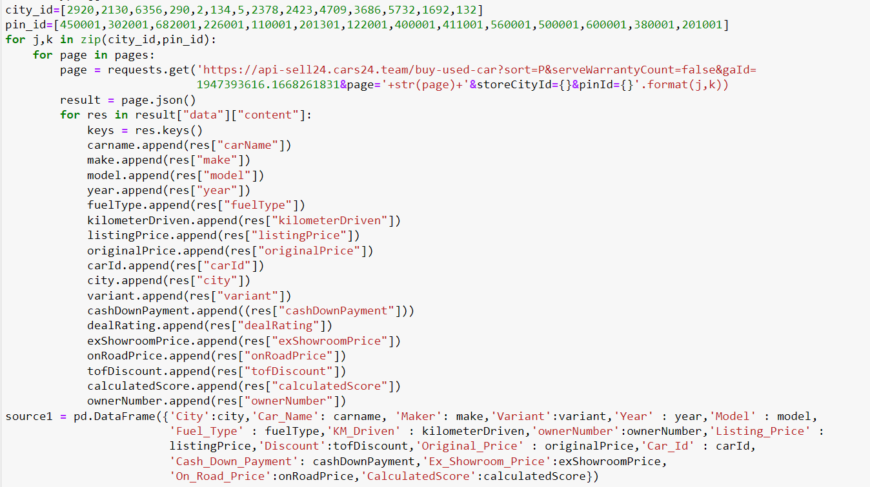
WEB SCRAPING AND CREATE A DATA FRAME

Slide 6
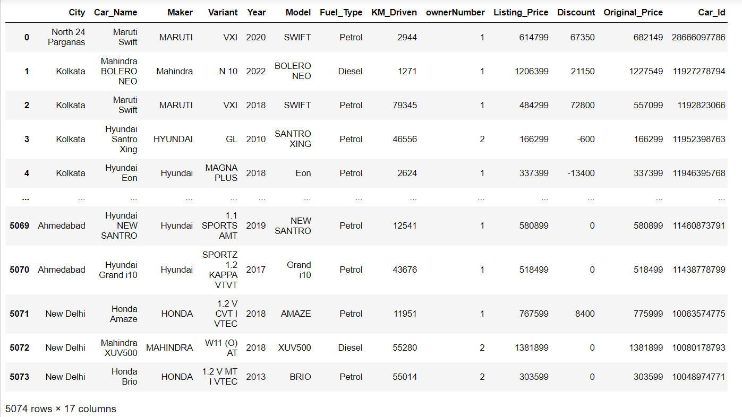
WEB SCRAPING AND CREATE A DATA FRAME

Slide 7
Data Summary
After web scrapping we got a dataset of csv file: cars24_final.csv
Cars24_final dataset:
City
Car_Name
Maker
Variant
Year
Model
Fuel_Type
KM_Driven
Owner numbers
Listing Price
Discount
Car_id
Cash_Down_Payment
Calculated Score: An approximate refurbishment cost based on the prices of spare parts and labor costs associated is calculated
Ex_Showroom_Price: It consists of all charges including manufacturing, transport, dealer’s margin, pre-delivery inspection (PDI) costs and the GST levied on the car
On_Road Price: Ex-showroom price + RTO road tax + Insurance + Fastag&Number plate
Original_Price: The price that you see of your car on CARS24 Website.
Shape of Dataset - (5074, 17)

Slide 8
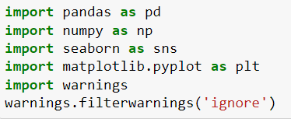
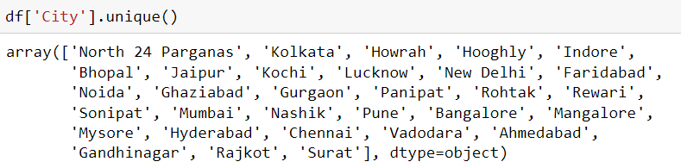
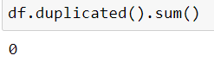
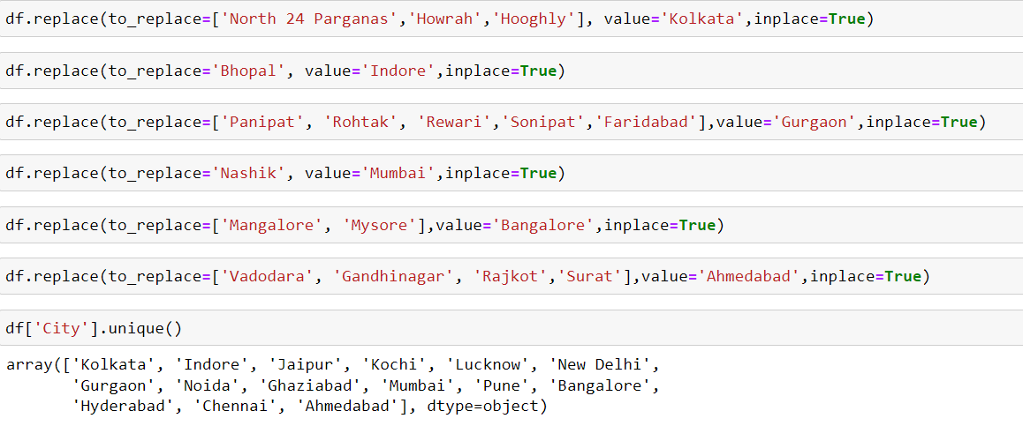
Data Pre-processing

Slide 9
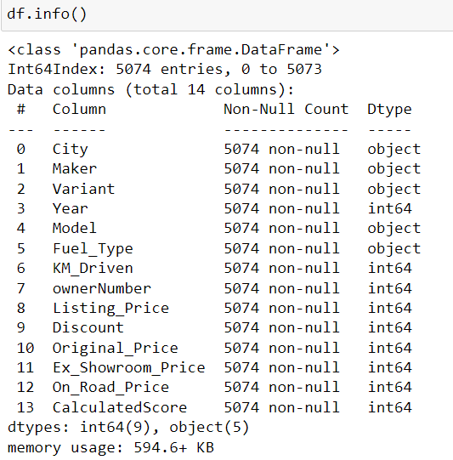
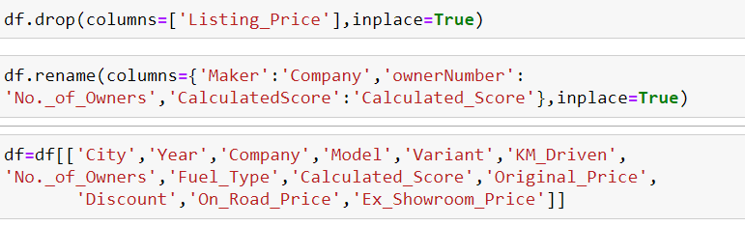
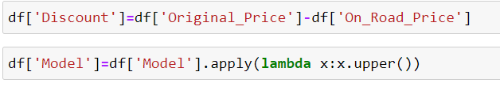
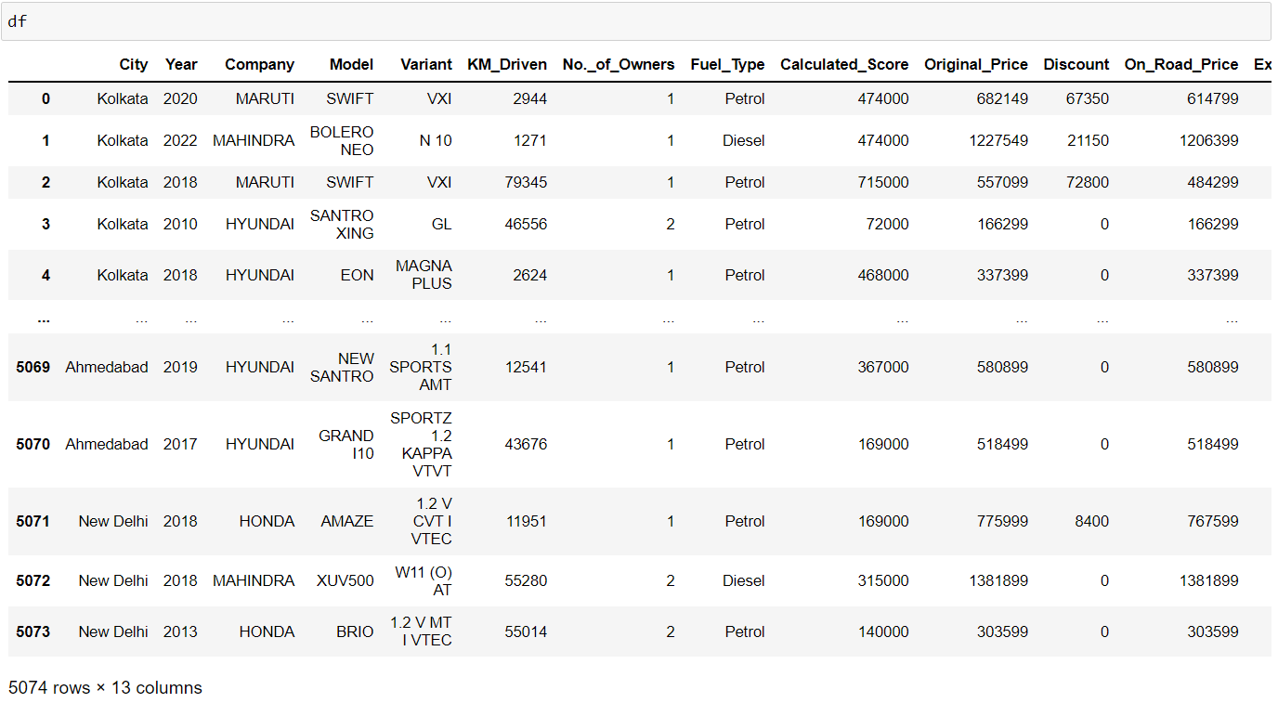
Data Pre-processing

Slide 10
Data Summary
After Data-preprocessing we got cars24_final dataset.
Cars24_final dataset:
City
Year
Company
Model
Variant
KM_Driven
No._Of_Owners
Fuel_Type
Discount
Calculated Score: An approximate refurbishment cost based on the prices
of spare parts and labor costs associated is calculated
Ex_Showroom_Price: It consists of all charges including manufacturing, transport, dealer’s margin, pre-delivery inspection (PDI) costs and the GST levied on the car
On_Road Price: Ex-showroom price + RTO road tax + Insurance + Fastag & Number plate
Original_Price: The price that you see of your car on CARS24 Website.
Shape of Dataset - (5074, 13)

Slide 11
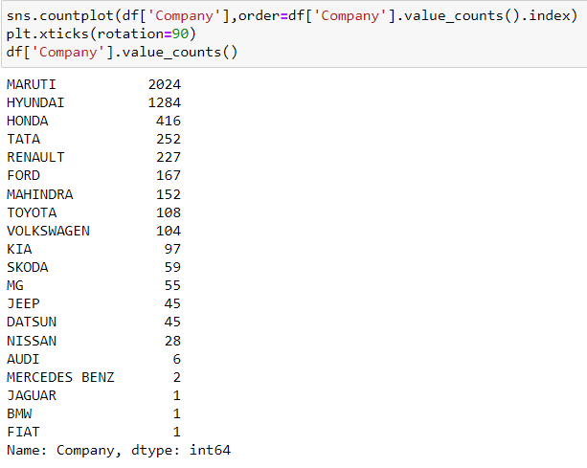
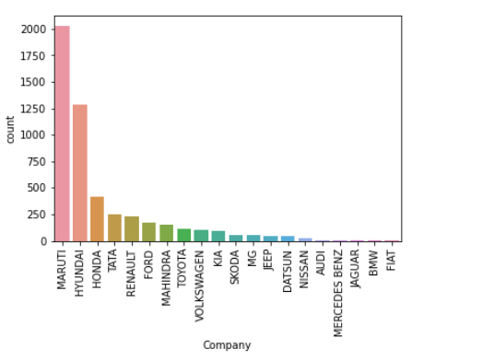
Analysis of different datasets
Observations of car’s companies
Splitting Companies column and analyzing No. of Cars in that company.
Maximum No. of Cars is of Maruti then Hyundai and so on.

Slide 12
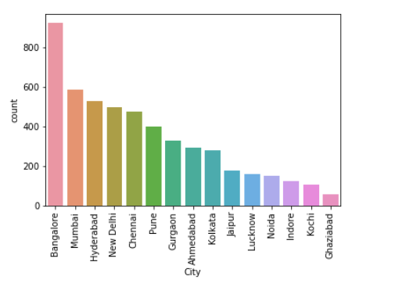
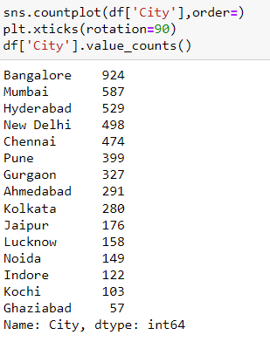
Observations of cities
Splitting Cities column and analyzing No. of Cars in that City.
Maximum No. of Cars is from Bangalore then Mumbai and so on.

Slide 13
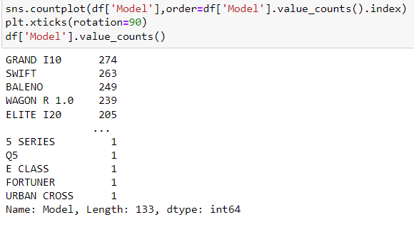
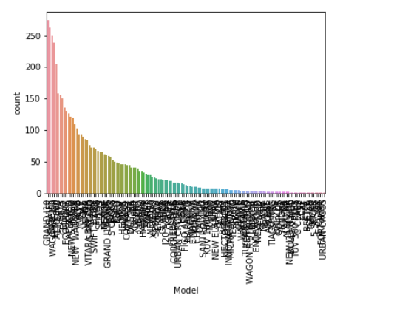
Observations of car’s models
Splitting Models column and analyzing No. of Cars of that Model.
Maximum No. of Cars model is Grand I10 then Swift and so on.

Slide 14
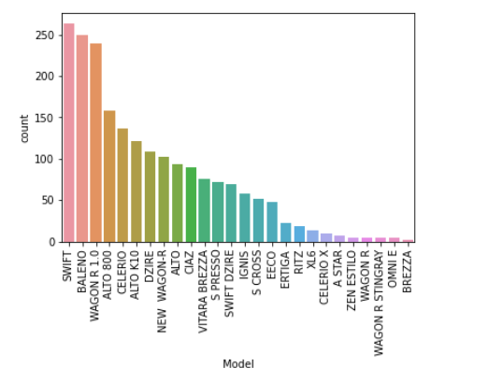
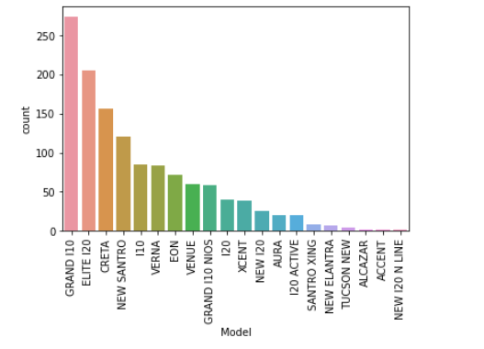
Observations of top 5 companies models based on No. of Cars in all cities
Companies are: Maruti, Hyundai, Honda, Tata and Renault

Slide 15
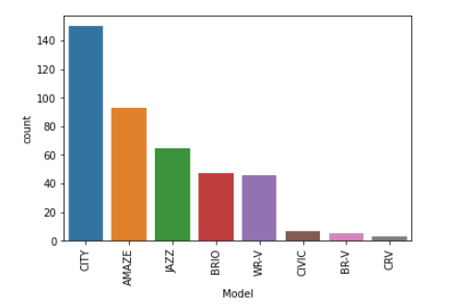
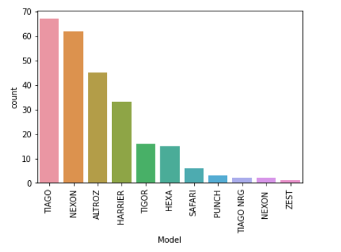
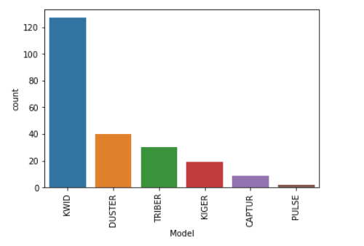
Observations of top 5 companies models based on No. of Cars in all cities
Companies are: Maruti, Hyundai, Honda, Tata and Renault

Slide 16
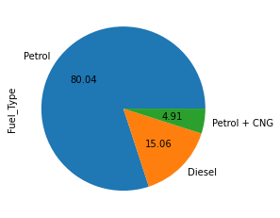
Observations of Type of fuel
Splitting Fuel type column and analyzing % of type of fuel.
Maximum type of fuel is Petrol then Diesel and Petrol + CNG.

Slide 17
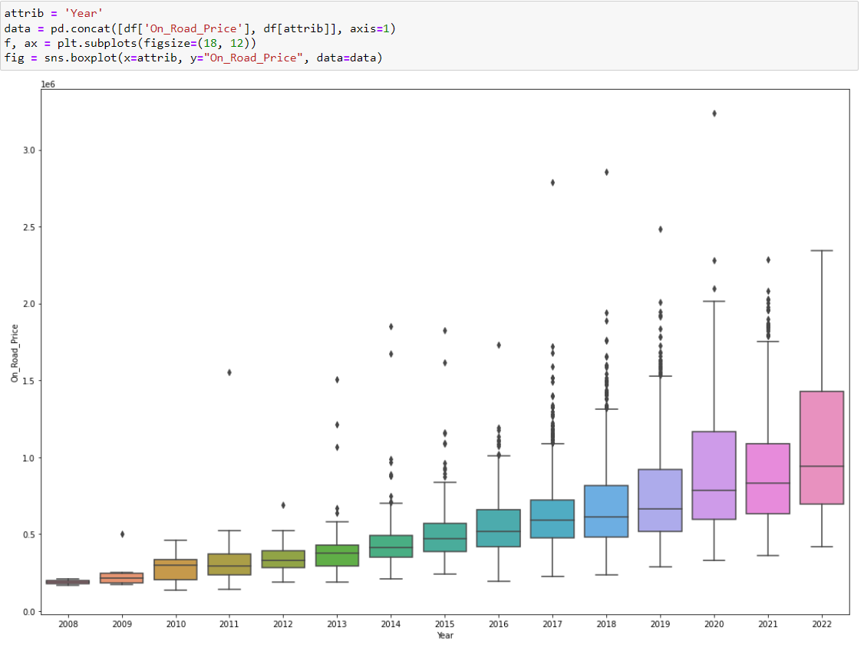
Observations of price based on years
As the year increases the price of car’s is also increases.

Slide 18
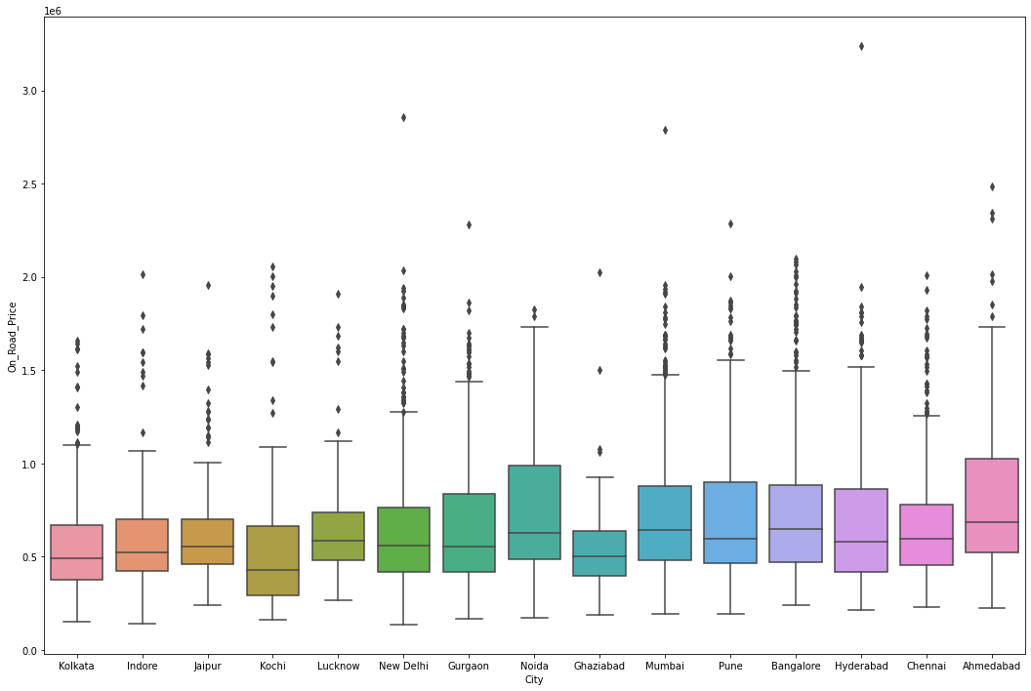
Observations of price based on cities
There is not significant changes in price w.r.t. cities.

Slide 19
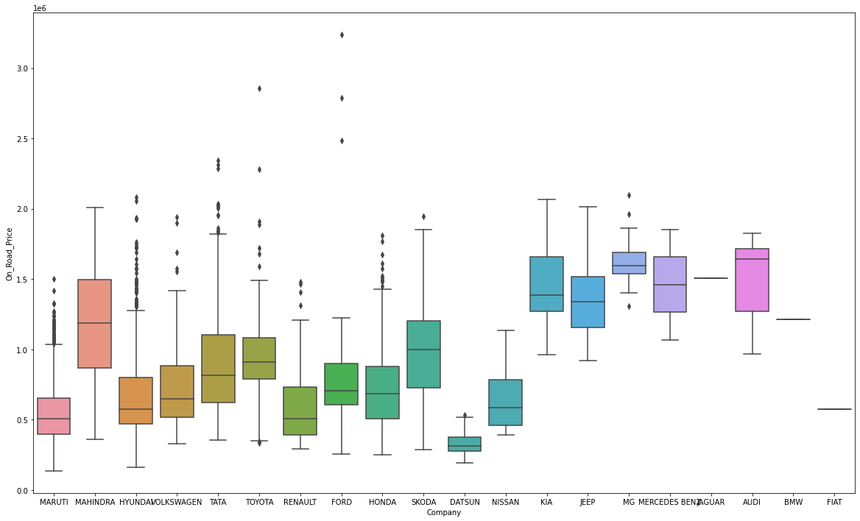
Observations of price based on brand
Some of the luxury brand like KIA, JEEP,MG,AUDI,BMW are more costly than other brands.

Slide 20
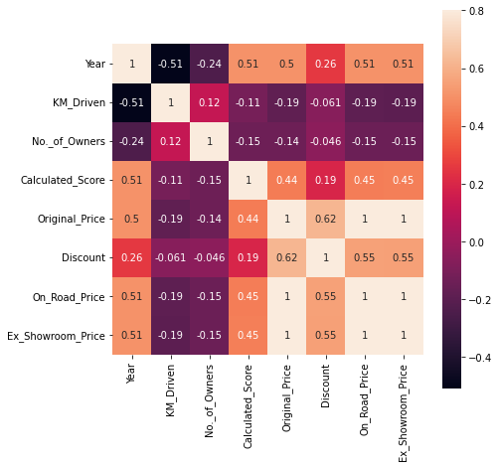
Correlations of price with Numerical var
There is negative correlation of price with KM Driven and No. of Owners.

Slide 21
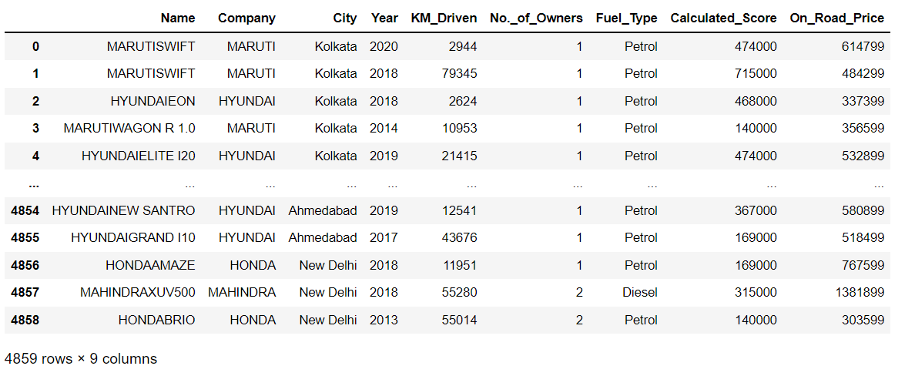
after imputing missing values and outlier treatment
The Final Dataset to build the model.

Slide 22
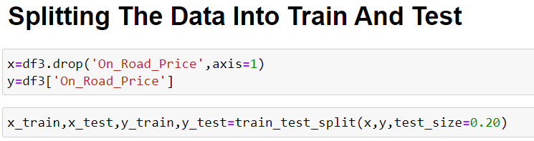
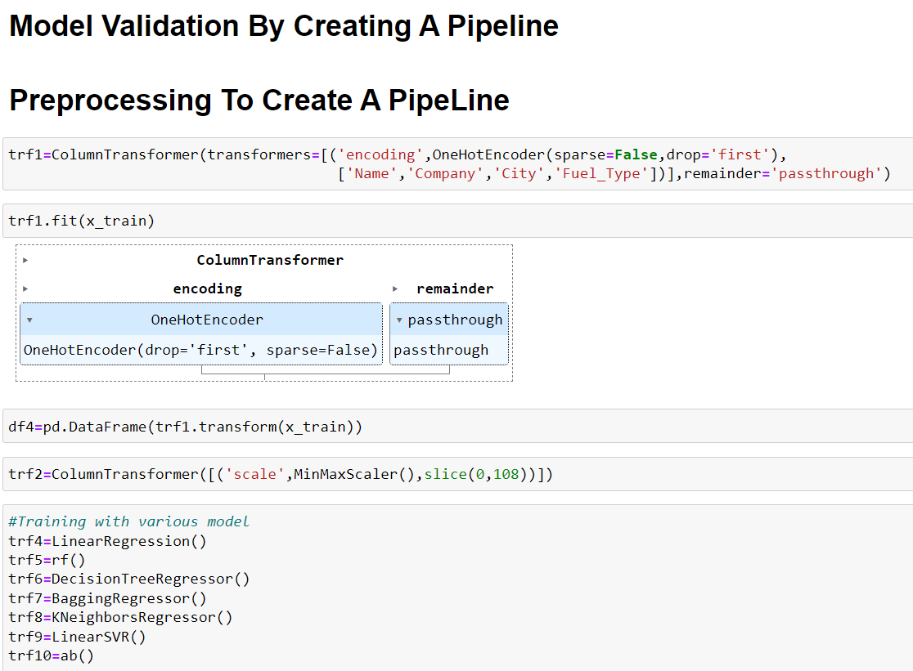
model building

Slide 23
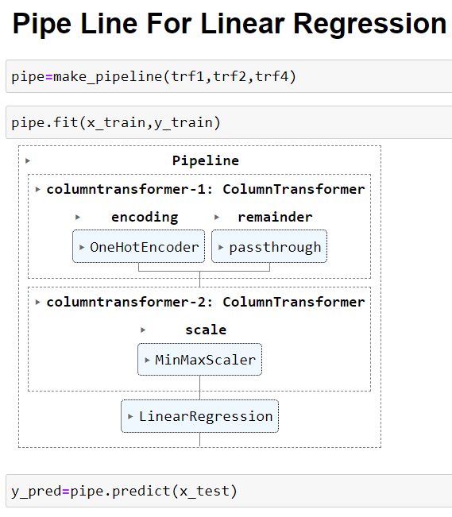
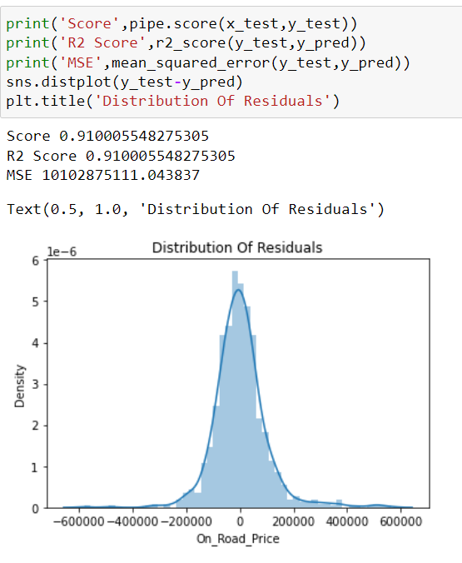
1. Linear Regression
Here we create a pipeline for linear regression, check the accuracy and plot the distribution of Residuals.

Slide 24
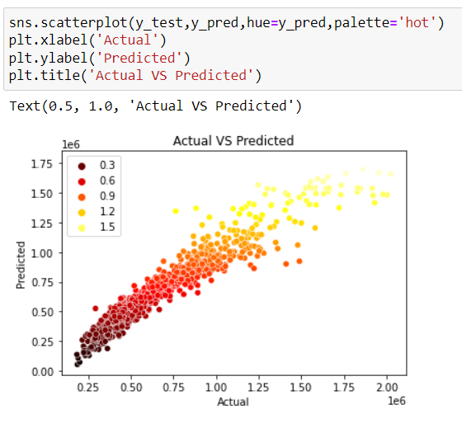
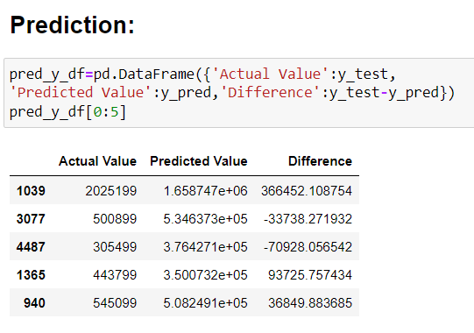
1. Linear Regression
Here we plot a scatter plot between actual and predicted values and also see the difference in values.

Slide 25
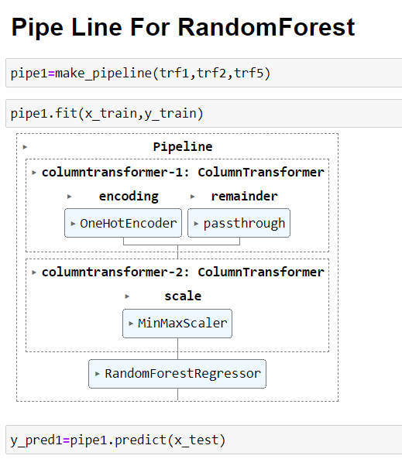
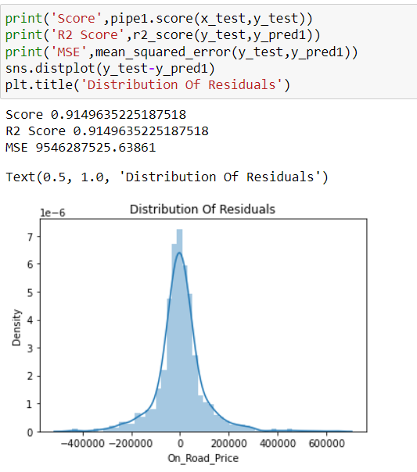
2. Random Forest
Here we create a pipeline for random forest, check the accuracy and plot the distribution of Residuals.

Slide 26
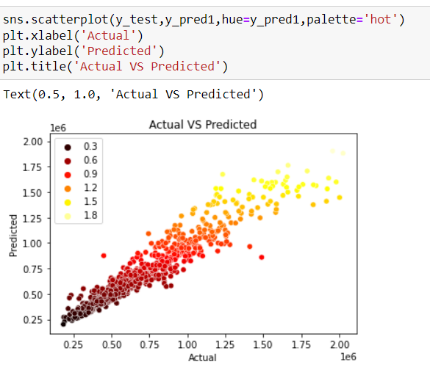
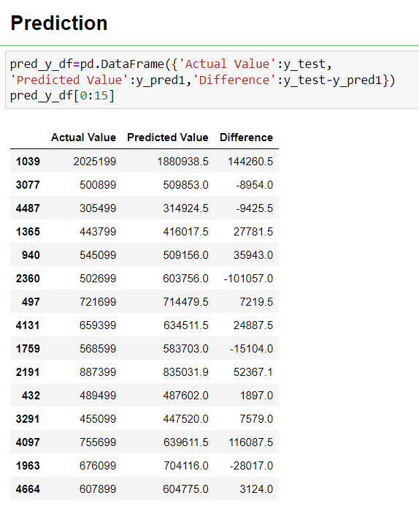
2. Random Forest
Here we plot a scatter plot between actual and predicted values and also see the difference in values.

Slide 27
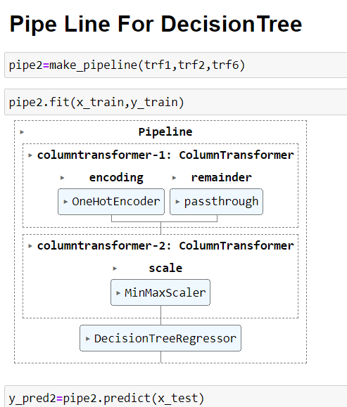
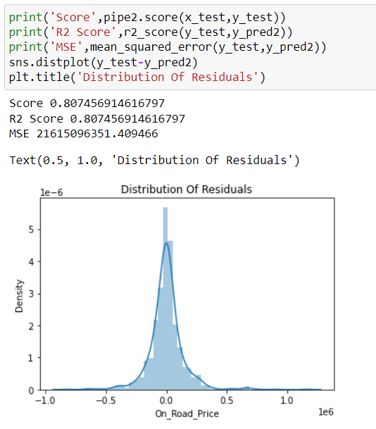
3. Decision Tree
Here we create a pipeline for decision tree, check the accuracy and plot the distribution of Residuals.

Slide 28
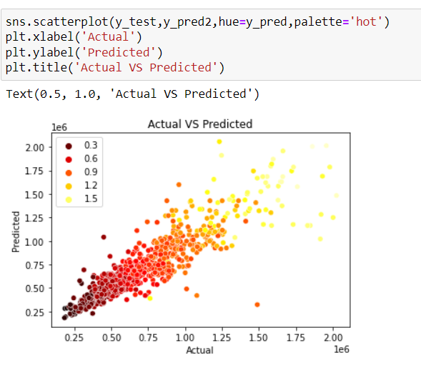
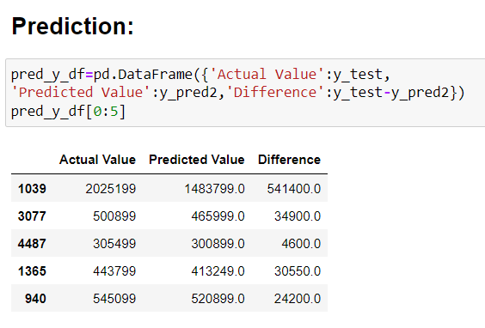
3. Decision Tree
Here we plot a scatter plot between actual and predicted values and also see the difference in values.

Slide 29
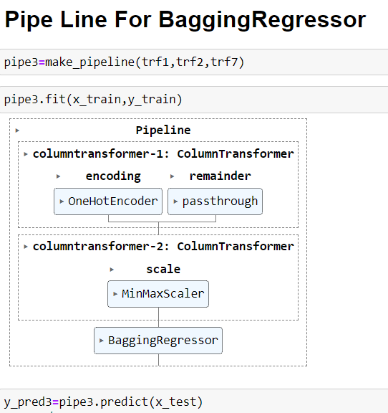
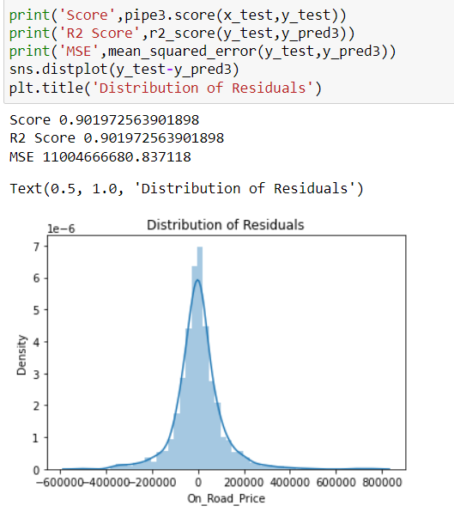
4. Bagging regressor
Here we create a pipeline for bagging regressor, check the accuracy and plot the distribution of Residuals.

Slide 30
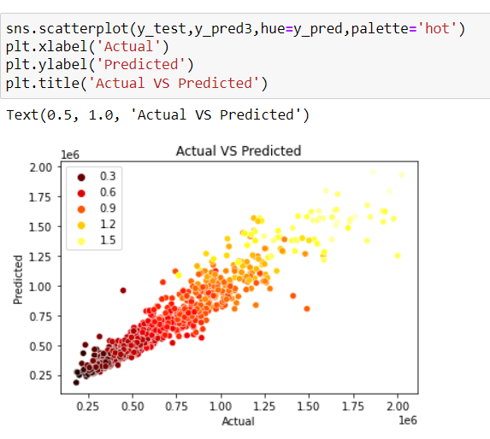
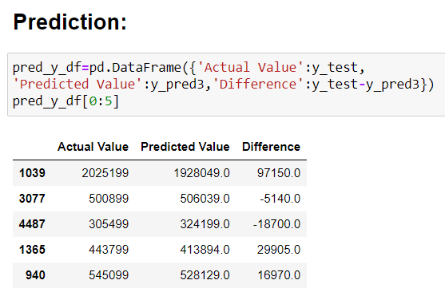
4. Bagging regressor
Here we plot a scatter plot between actual and predicted values and also see the difference in values.

Slide 31
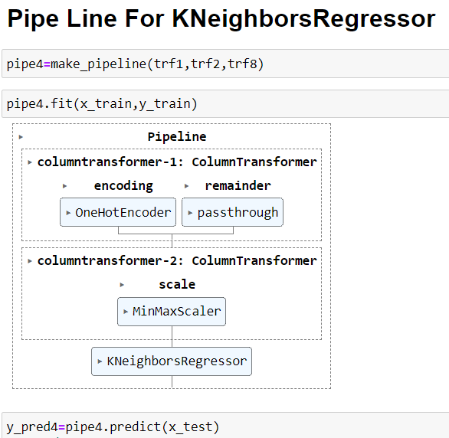
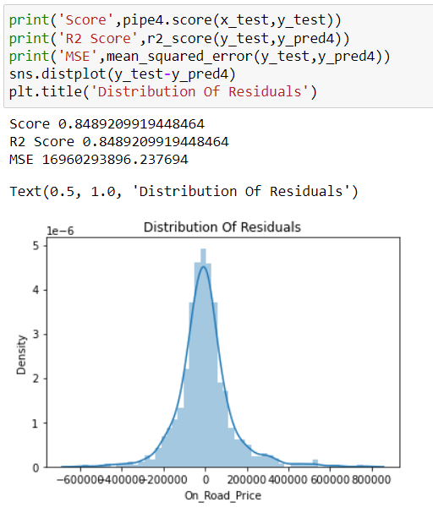
5. K neighbors regressor
Here we create a pipeline for K Neighbors regressor, check the accuracy and plot the distribution of Residuals.

Slide 32
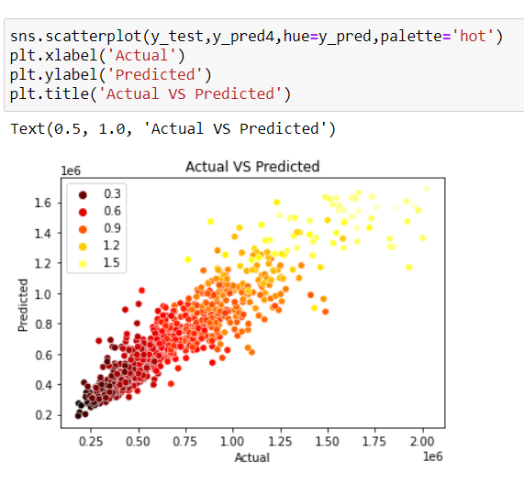

5. K neighbors regressor
Here we plot a scatter plot between actual and predicted values and also see the difference in values.

Slide 33


6. Support vector regressor
Here we create a pipeline for support vector regressor, check the accuracy and plot the distribution of Residuals.

Slide 34


6. Support vector regressor
Here we plot a scatter plot between actual and predicted values and also see the difference in values.

Slide 35


7. Ada boost regressor
Here we create a pipeline for Adaboost Regressor, check the accuracy and plot the distribution of Residuals.

Slide 36


7. Ada boost regressor
Here we plot a scatter plot between actual and predicted values and also see the difference in values.

Slide 37


8. Voting regressor
Here we create a pipeline for Voting regressor, check the accuracy and plot the distribution of Residuals.

Slide 38


8. Voting regressor
Here we plot a scatter plot between actual and predicted values and also see the difference in values.

Slide 39



Model deployment using stream lit

Slide 40


Model deployment using stream lit

Slide 41




Model deployment using stream lit

Slide 42


Model deployment using stream lit

Slide 43
conclusion
By Performing different ML models, we aim to get a maximum accuracy with less error.
Initially we perform web scrapping to find the dataset from cars24 website then we clean the data and remove the null values and outliers from dataset.
Next with the help of data visualization features were explored deeply. The relation between the feature is examined
Then from different model we conclude that the voting regressor which includes Linear Regression, Decision Tree and Random Forest have less error and maximum R2 Score.

Slide 44
challenges
Data Scrapping and Data Cleaning from Cars24 website, removing the unwanted columns and duplicated values for finalize the dataset to feed into the model.
In model building to create a pipeline using the dataset.
Make a dashboard page by concat it with the prediction page.

Slide 45
Future scope
In future this machine learning model may bind with various website which can provide real time data for price prediction. Also we may add large historical data of car price which can help to improve accuracy of the machine learning model.
We can build an android app as user interface for interacting with users.
For better performance, we plan to judiciously design deep learning network structures, use the adaptive leaning rates and train on clusters of data rather than the whole datasets.

Slide 46


